Slide 1
LESSON SEVEN
TOPICS: HOW TO MAKE THE SHERIFF SHOOT A GUN.

Slide 2
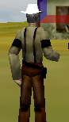
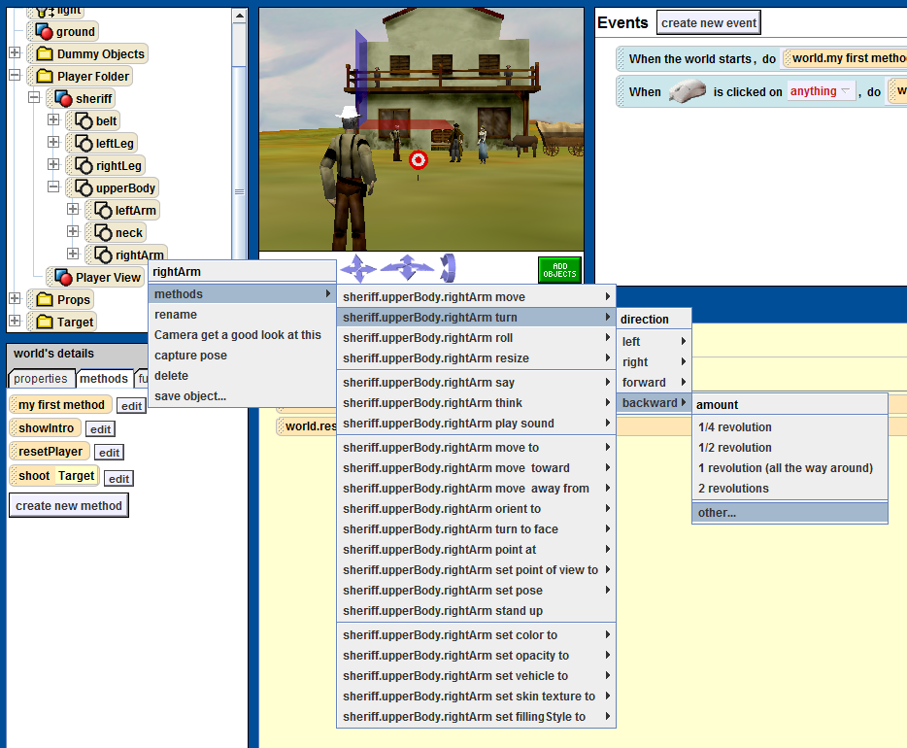
Step 1: Position the Sheriff’s Arm, Part 1
Rotate the sheriff’s right arm backward 0.15 revolutions.

Slide 3
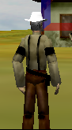
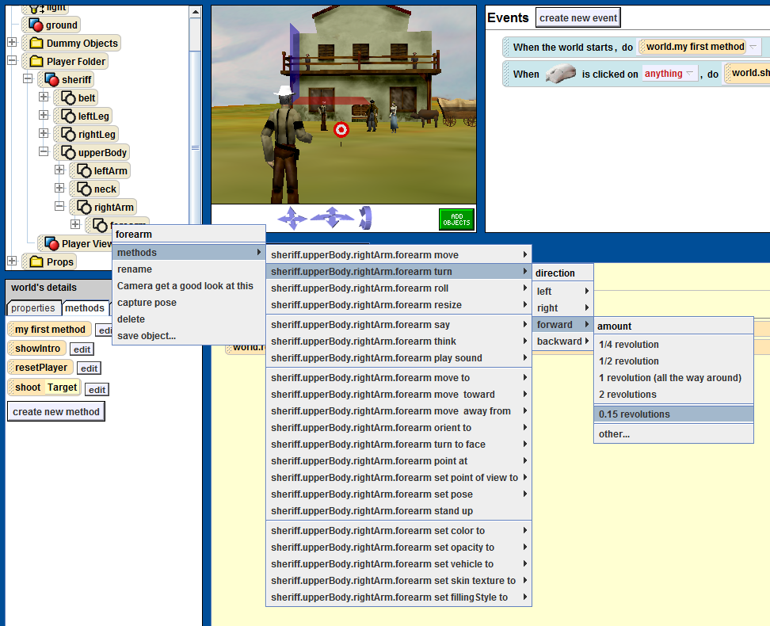
Step 2: Position the Sheriff’s Arm, Part 2
Rotate the sheriff’s right forearm forwards 0.15 revolutions.

Slide 4
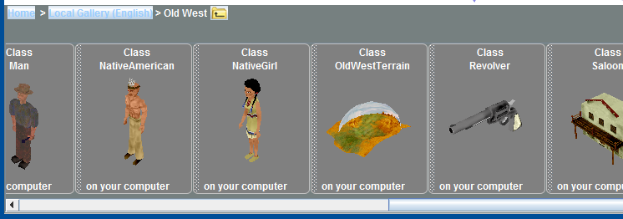
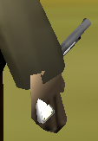
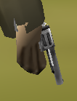
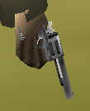
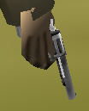
Step 3: Add the Sheriff’s Revolver
Add the revolver from the “Old West” gallery to your Alice world.
Set the revolver’s point-of-view to the sheriff’s right hand.
Turn the revolver forward 0.30 revolutions.
Move the revolver forward 0.05 meters.
Move the revolver to the left 0.02 meters.

Slide 5
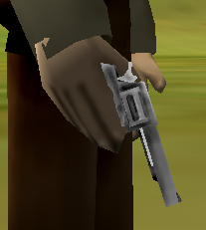
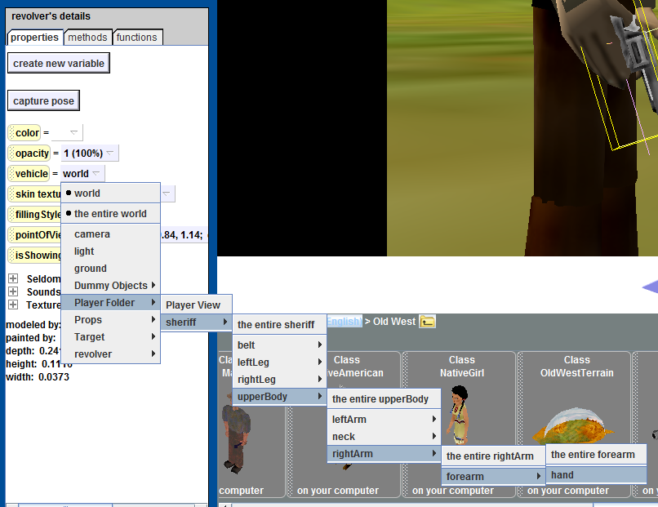
Step 4: Position the Sheriff’s Revolver
Move the revolver up 0.02 meters.
Set the vehicle of the revolver to the to the sheriff’s hand.

Slide 6
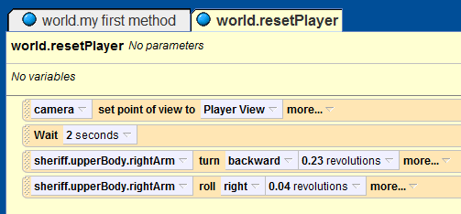
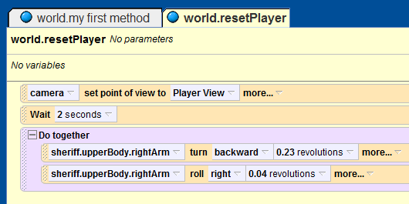
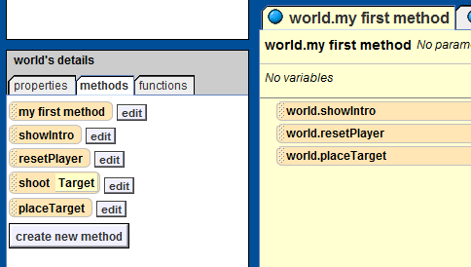
Step 5: Animate the Sheriff’s Arm
Add the line “sheriff.upperBody.rightArm.turn backward 0.23 revolutions” to the world.resetPlayer method.
Add the line “sheriff.upperBody.rightArm.roll.right 0.23 revolutions” to the world.resetPlayer method.
Play your world. Do you like the way it moves?
Add a “do together” statement to the world.resetPlayer method, and move the two new statements to it.
Create a new world method called “placeTarget”.
Call world.placeTarget from the “my first method” method.

Slide 7
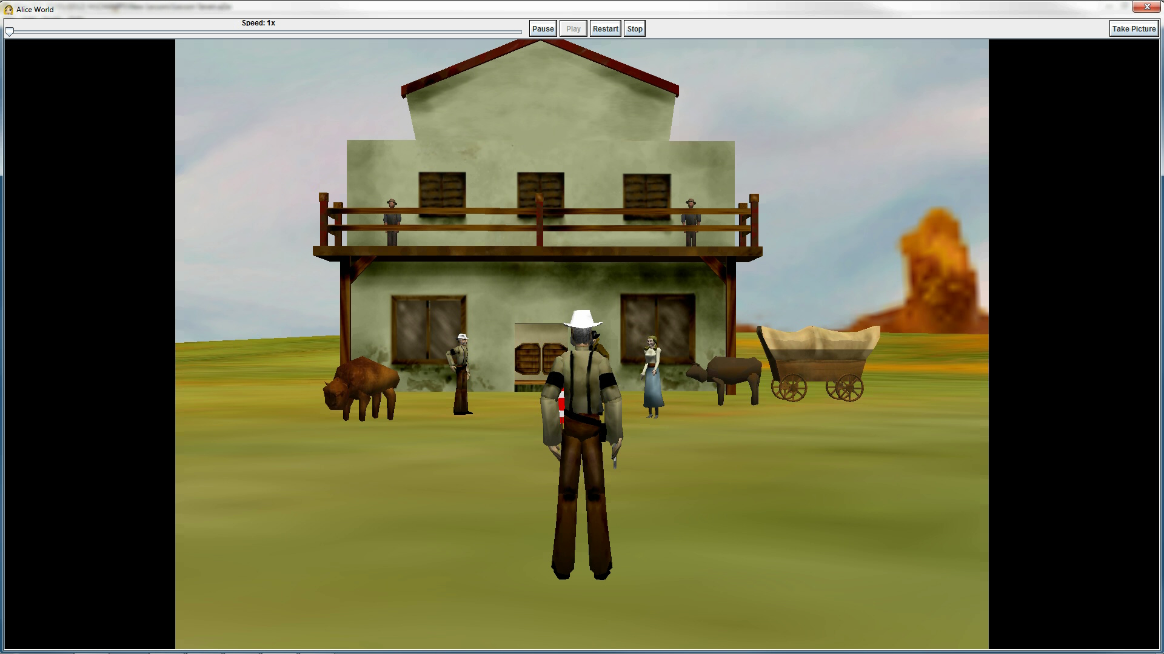
Final Scene

